Slide 1

HOW TO ORDER VITAL CERTIFICATES ONLINE USING VITAL DIRECTOR

Slide 2
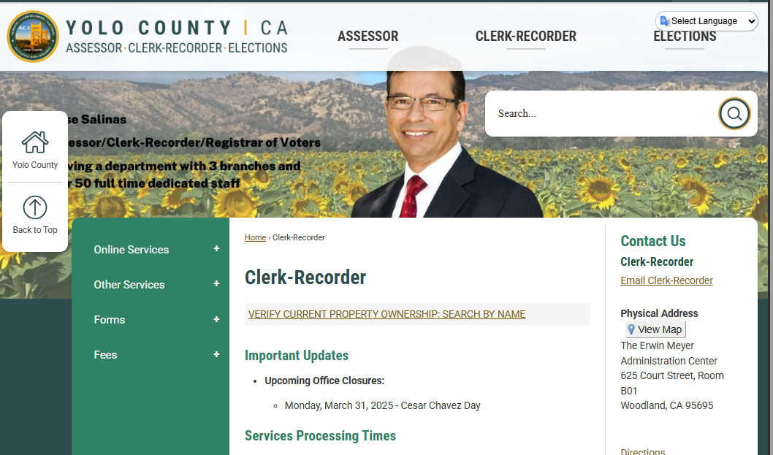
GO TO OUR HOME PAGE
Link: https://www.yolorecorder.org/31/Clerk-Recorder
Click on: Online Services

Slide 3
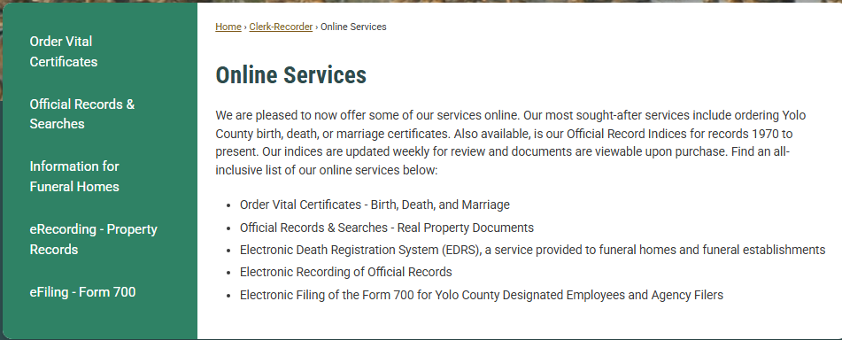

Slide 4
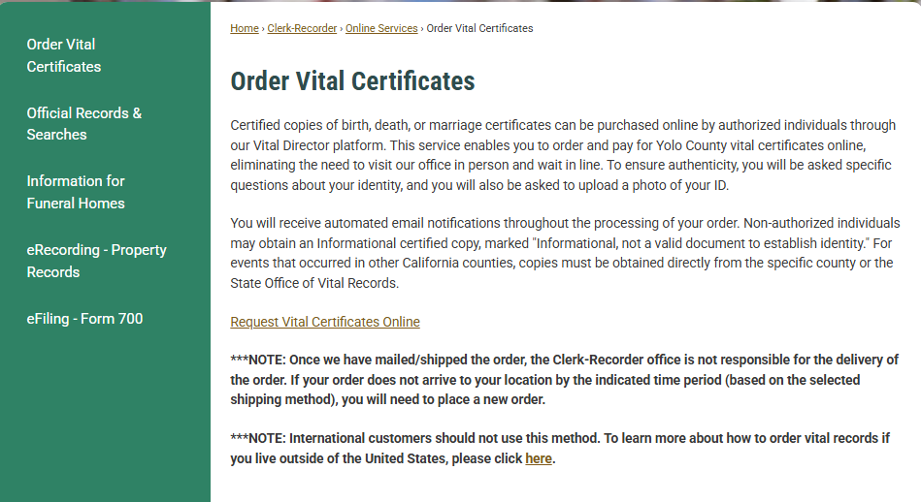

Slide 5
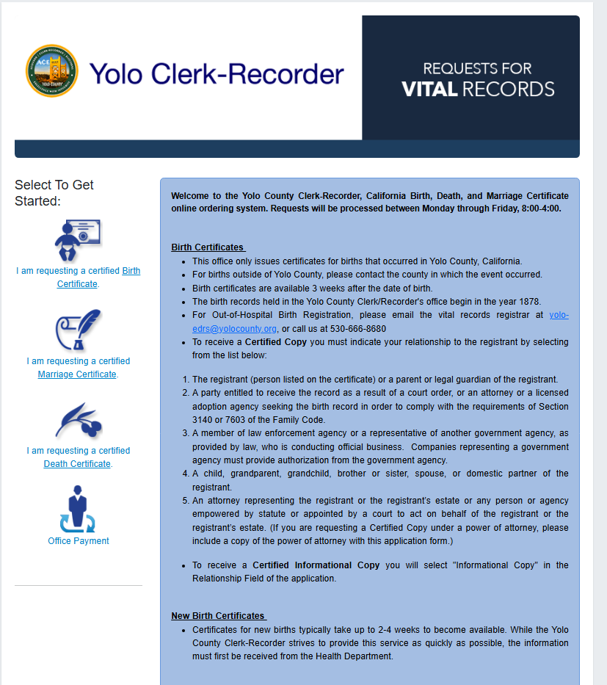

Slide 6

Birth Certificate

Slide 7
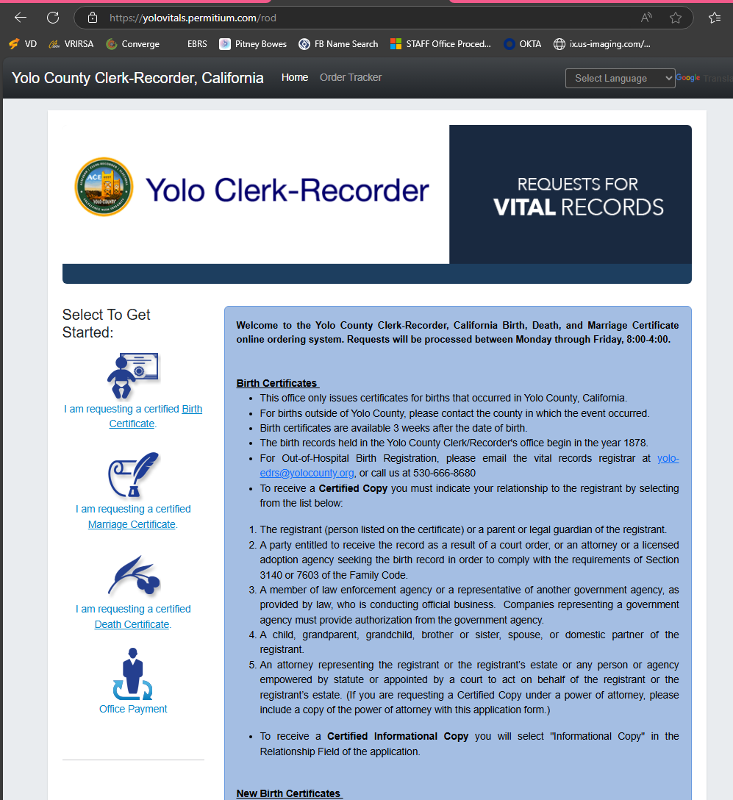
Requesting a Birth Certificate

Slide 8
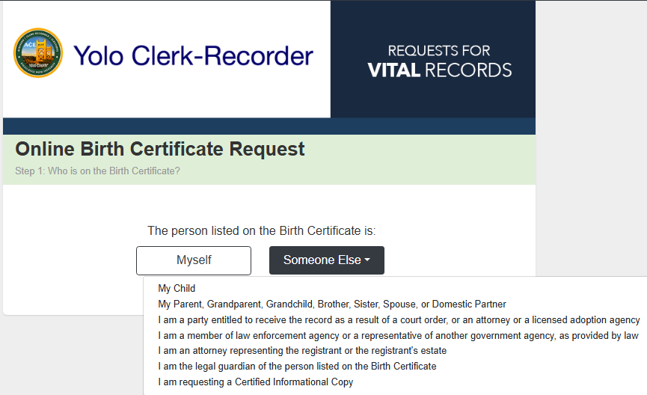
Requesting for Self
OR
Requesting for Someone Else

Slide 9
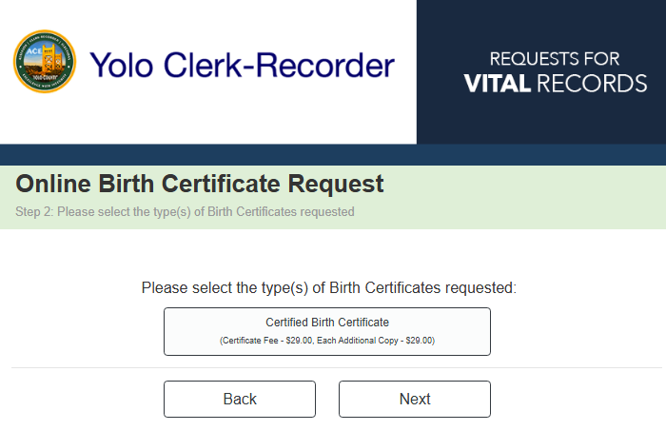

Slide 10
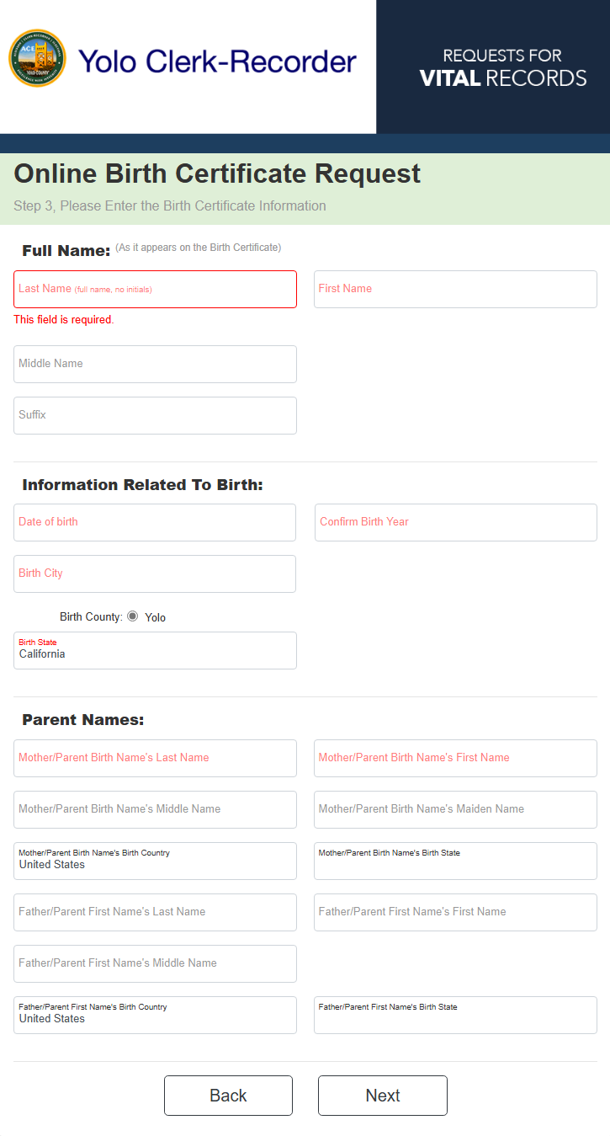


Slide 11
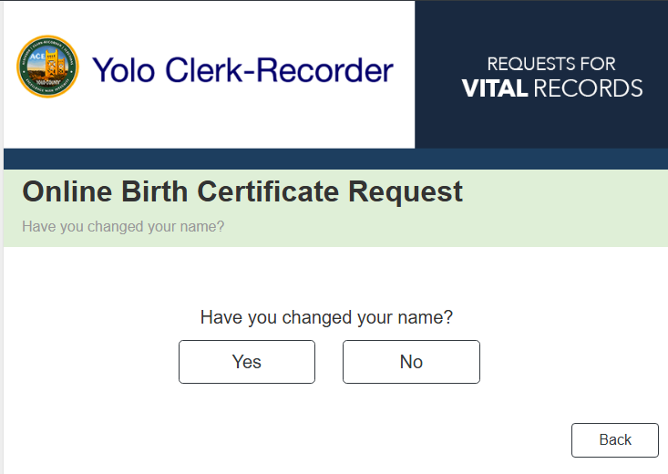
If you have changed your name due to a court order name change or an adoption process, please click yes.

Slide 12
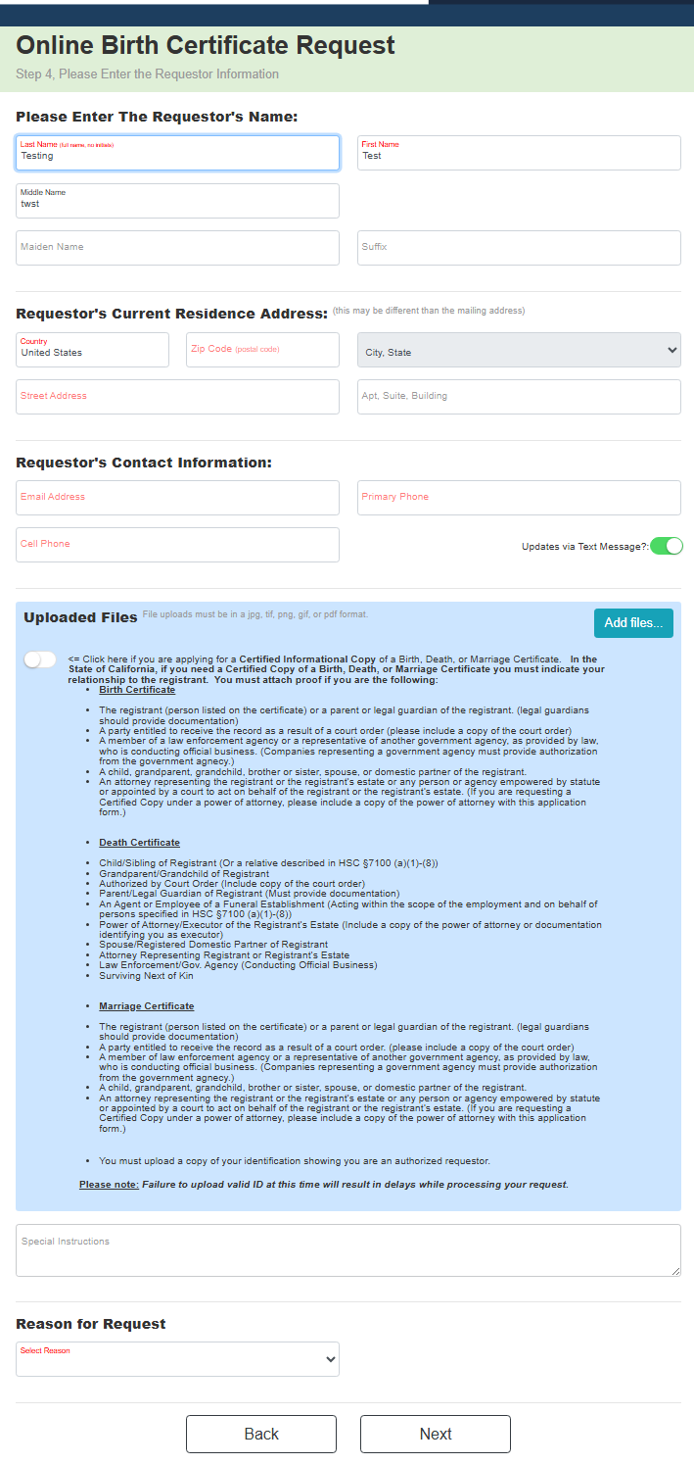
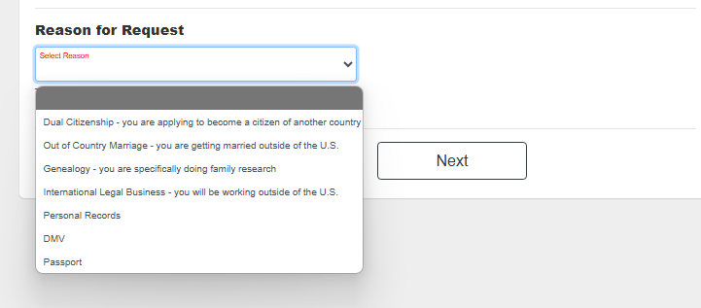
If Informational copy, select here
To add picture of ID select here

Slide 13
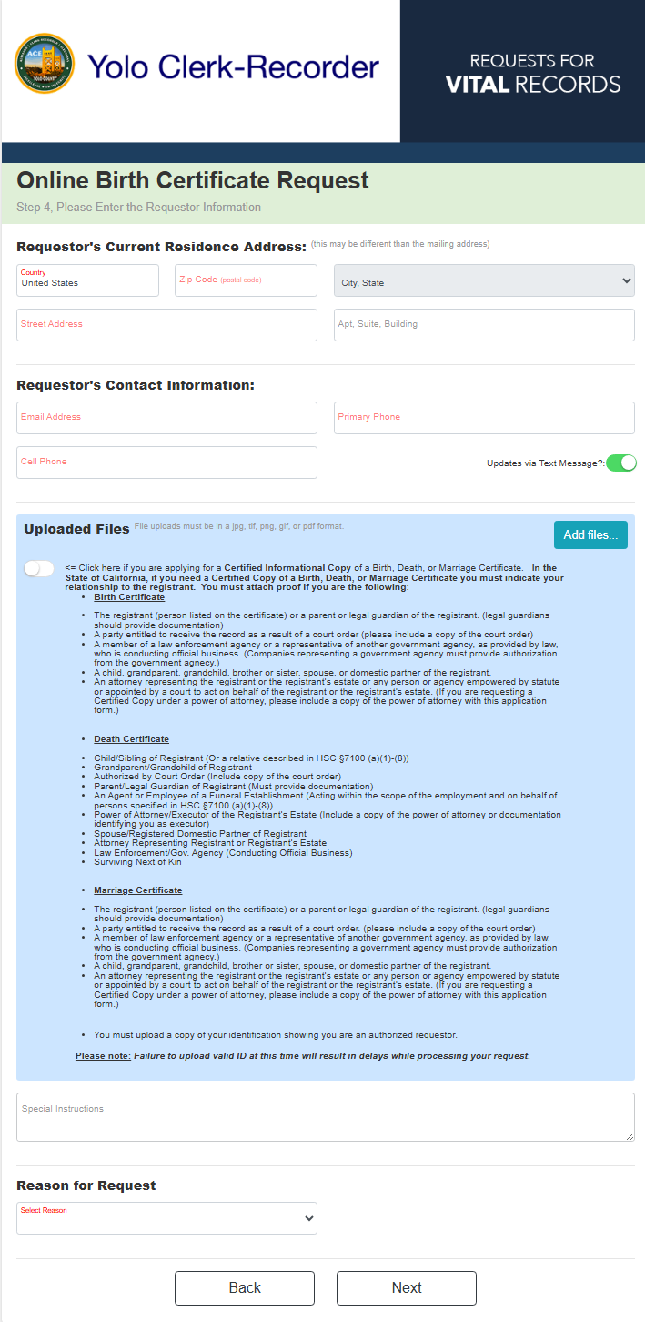

Slide 14
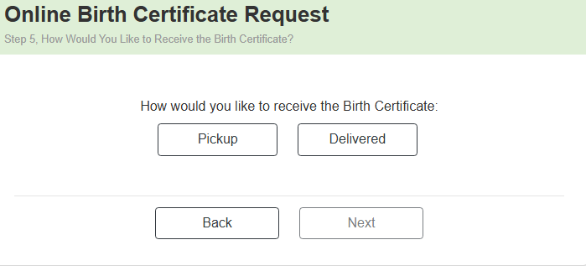
Pickup Order

Slide 15
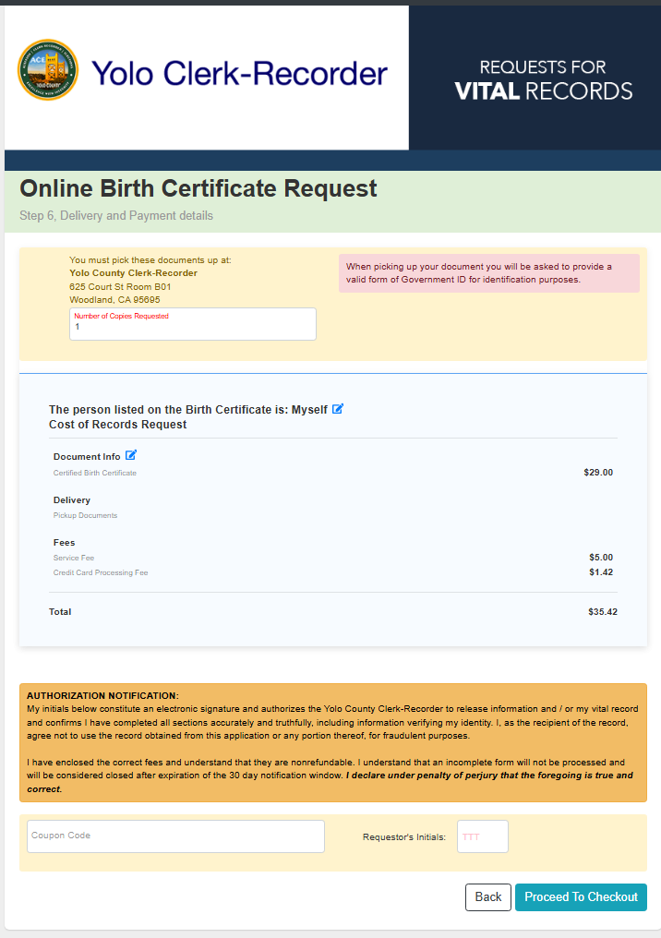
Add the number of copies you want to request
Add the Requestor’s Initials to proceed to checkout.

Slide 16
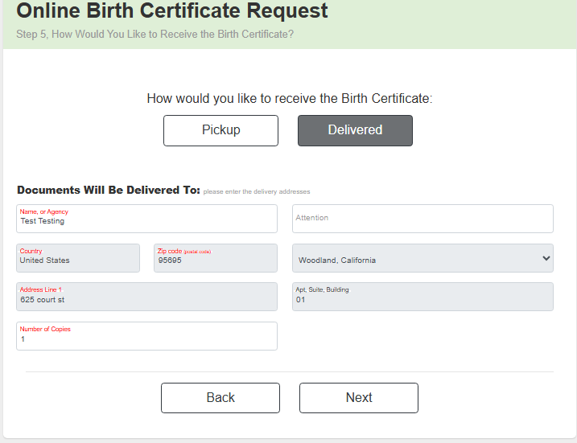
Add the number of copies you want to request

Slide 17
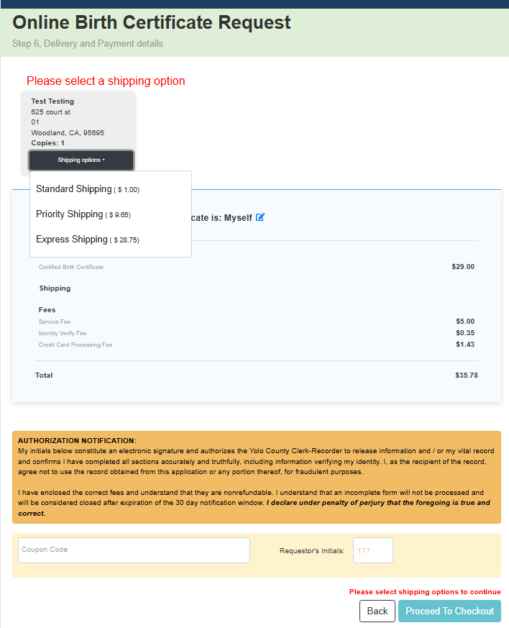
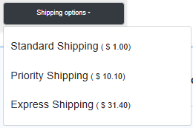
Standard Shipping does not come with tracking number.
Add the Requestor’s Initials to proceed to checkout.

Slide 18
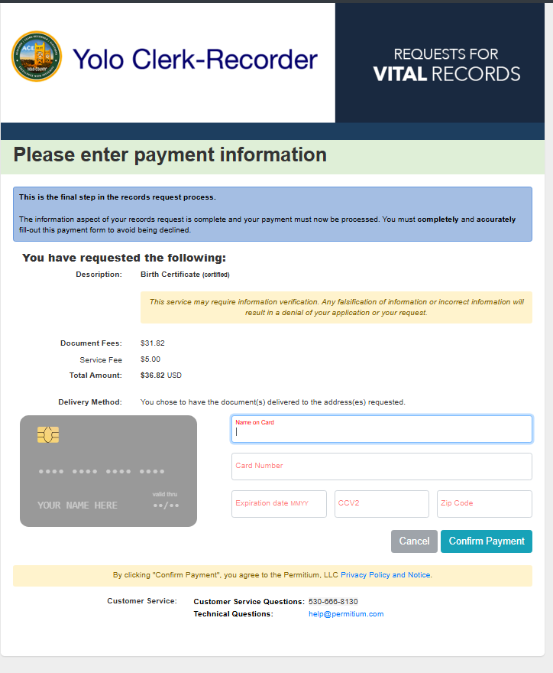
Payment Method must be US based, as well as address.
The CCV number are the 3 numbers in the back of the card.

Slide 19

MARRIAGE REQUEST

Slide 20
Requesting a Marriage Certificate

Slide 21
Requesting for Self
Requesting for Someone Else

Slide 22
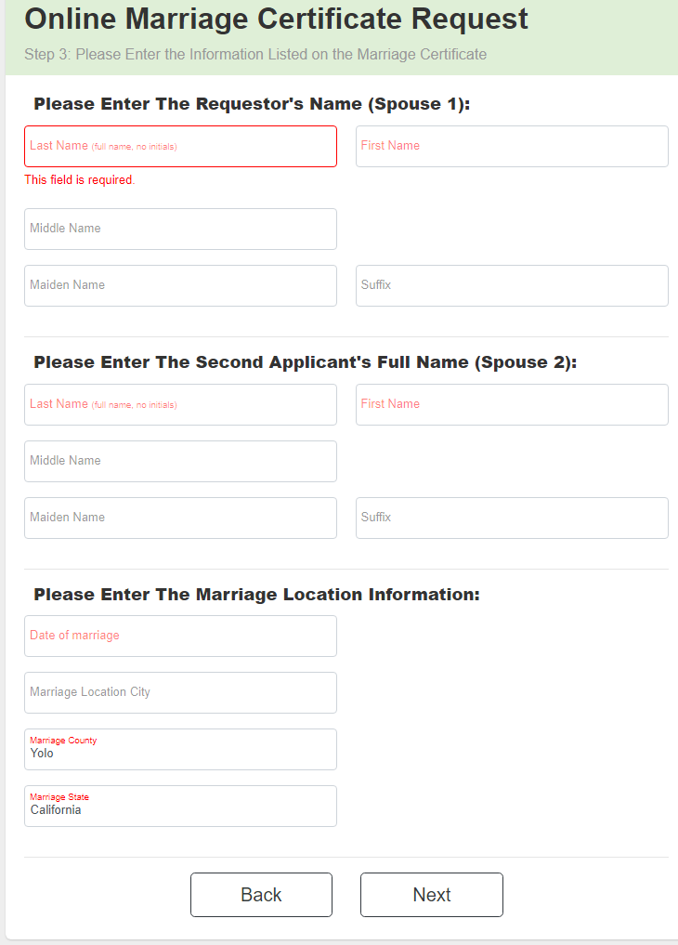


Slide 23
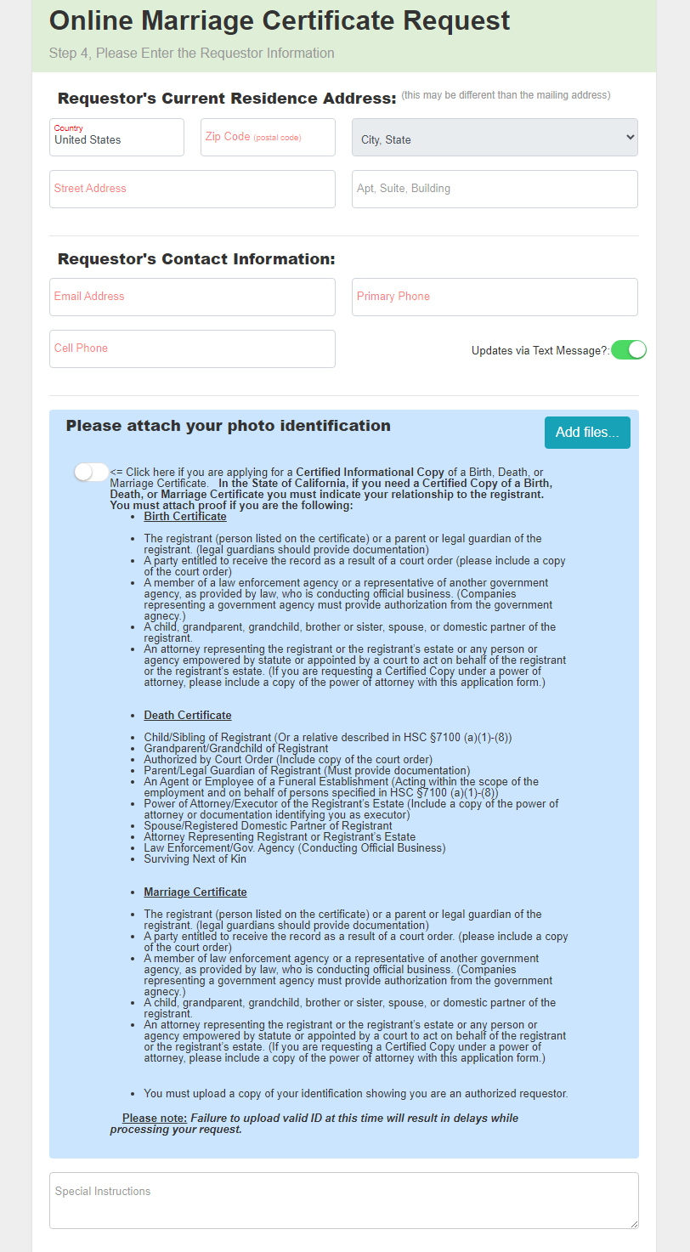
If you would like to receive updated via text message, click here.
Click here if you are requesting an Informational Copy of a Vital Record.
To upload a documents, please click the Add files… button.
According to the device you are in, there will be different options to upload your document.
Please add other information that can help us find the record or you can add and authorized individual if you can NOT pickup your record.

Slide 24
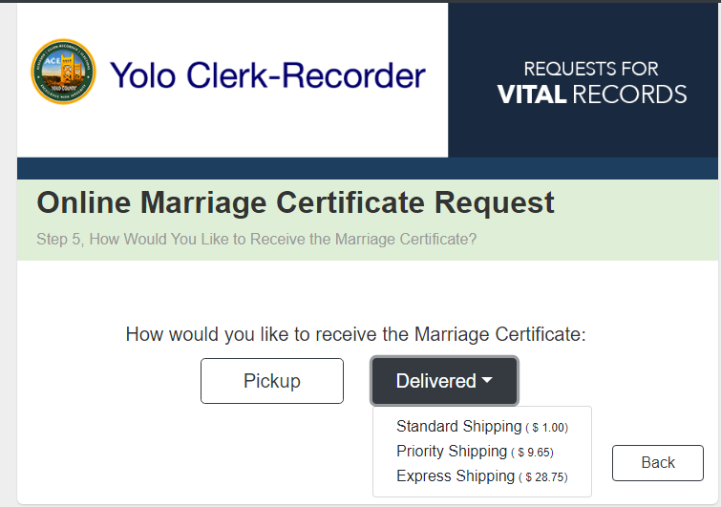
Standard Shipping does not come with tracking number.

Slide 25
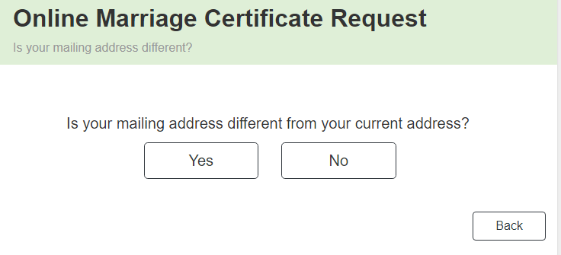
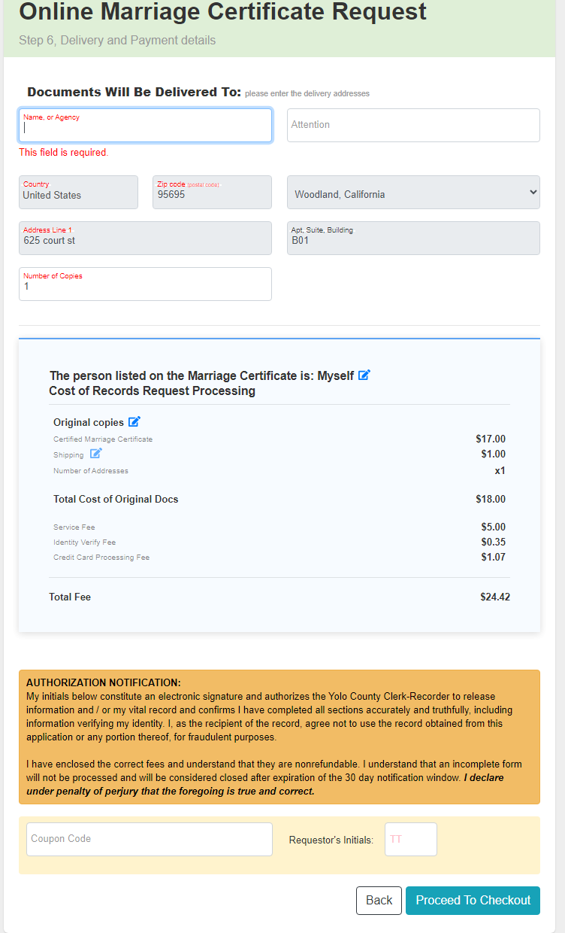
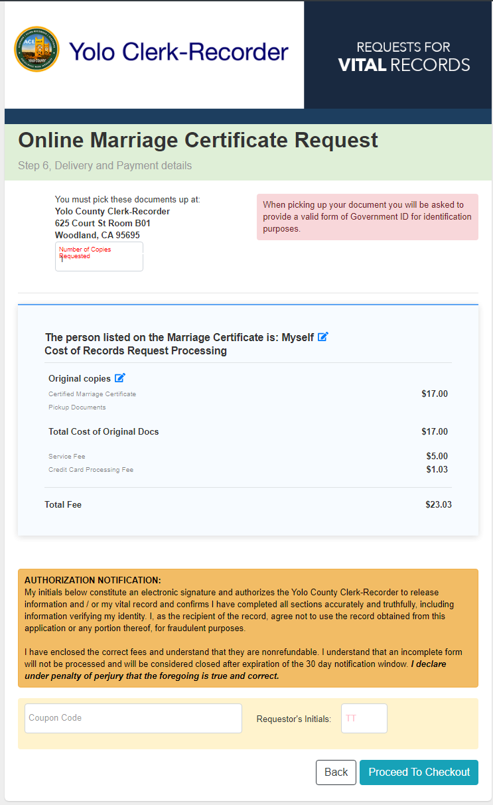

IF NO
Add the number of copies you want to request
IF YES
Add the number of copies you want to request
Add the Requestor’s Initials to proceed to checkout.

Slide 26
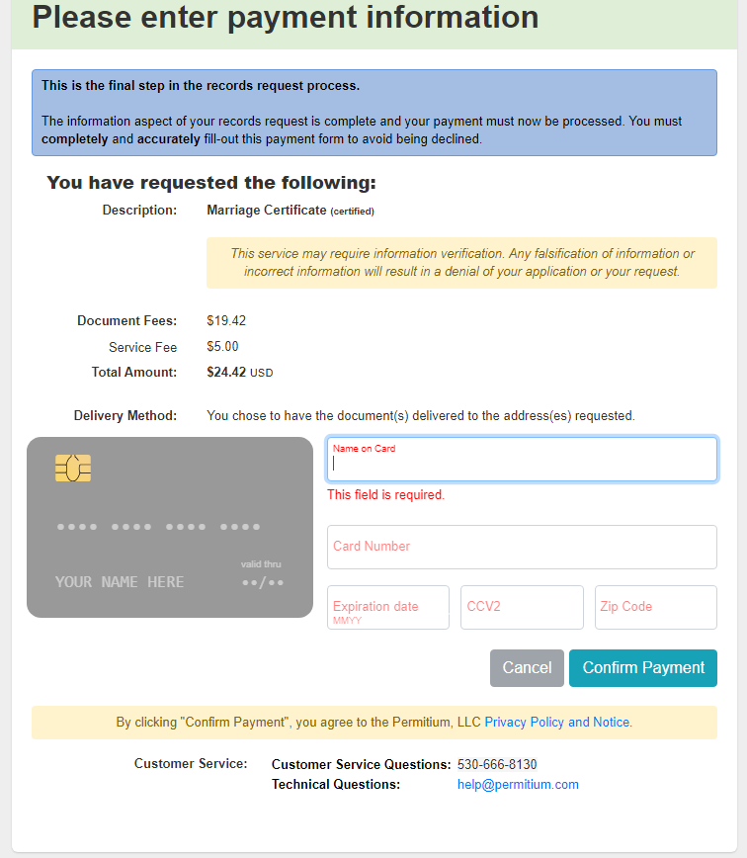
Payment Method must be US based, as well as address.
The CCV number are the 3 numbers in the back of the card.

Slide 27

Death Certificate Request

Slide 28
Requesting a Death Certificate

Slide 29
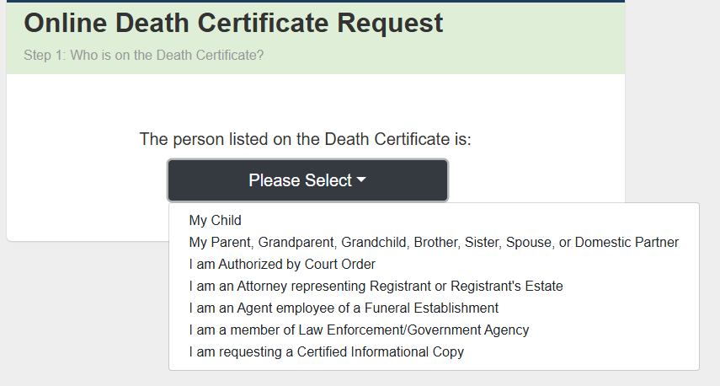
Select who you are to the person on the record.

Slide 30
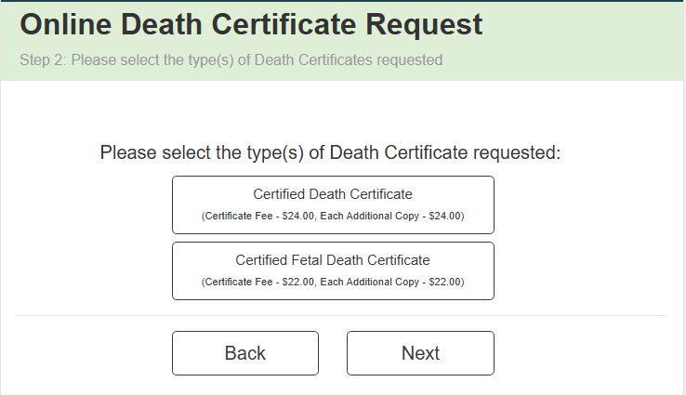


Slide 31
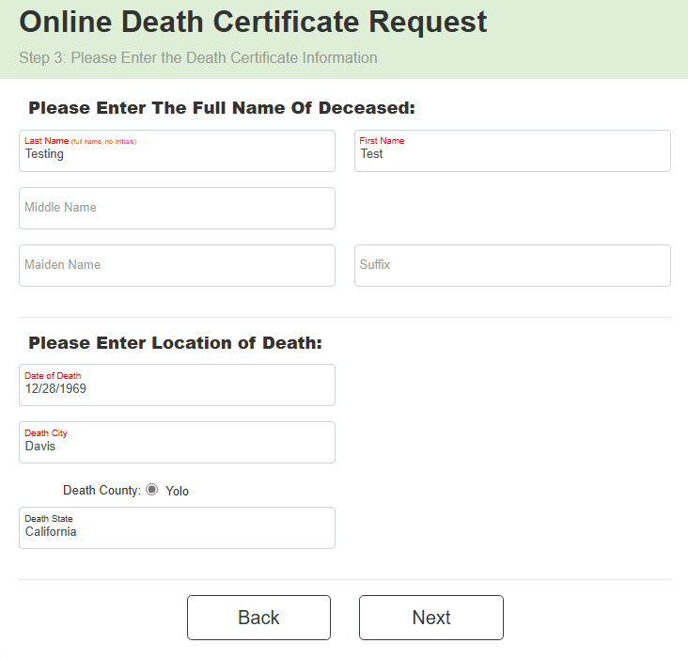

Slide 32
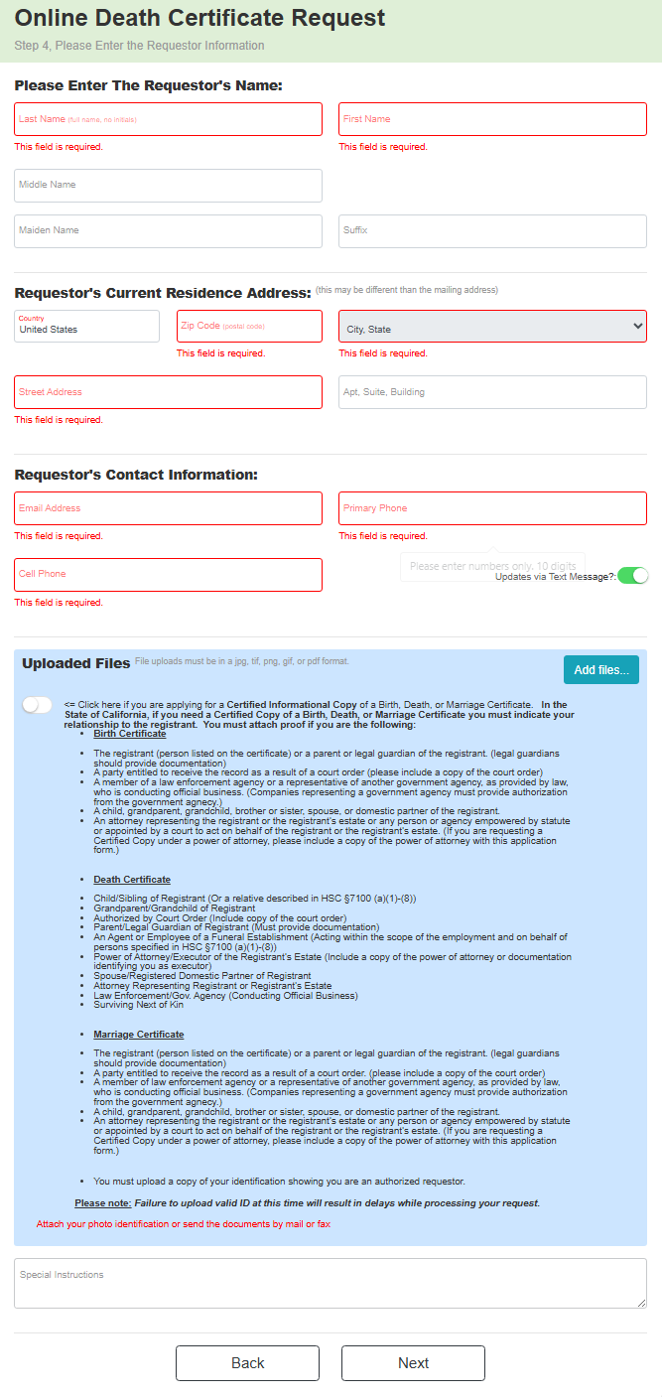
If Informational copy, select here
To add picture of ID select here
If someone else is picking up type in the name in the Special Instructions

Slide 33
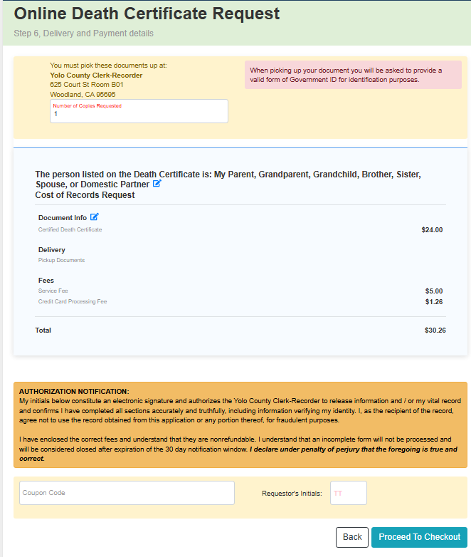
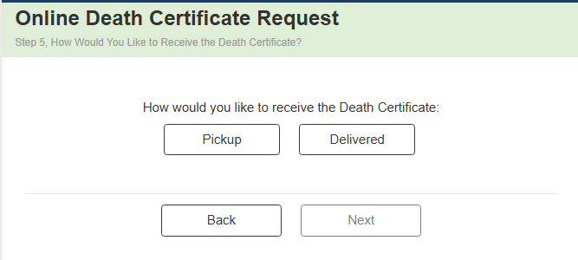
Add the number of copies you want to request
Add the Requestor’s Initials to proceed to checkout.

Slide 34
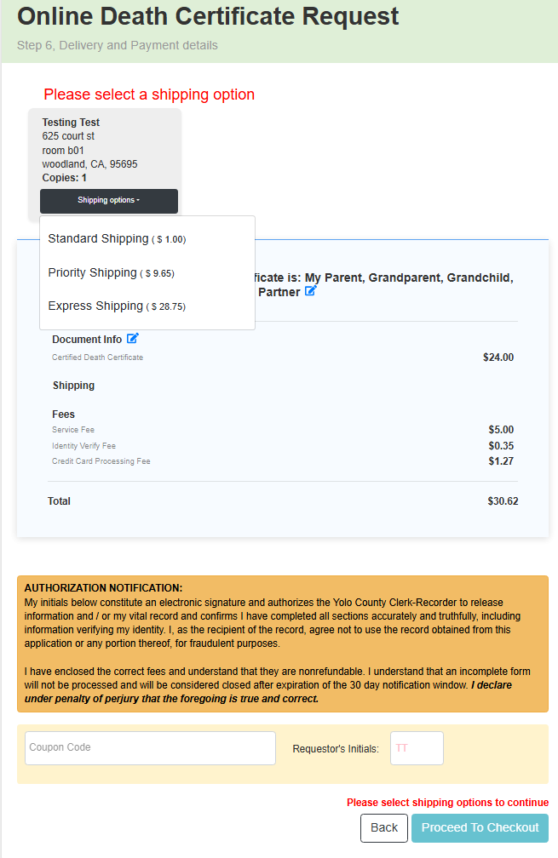
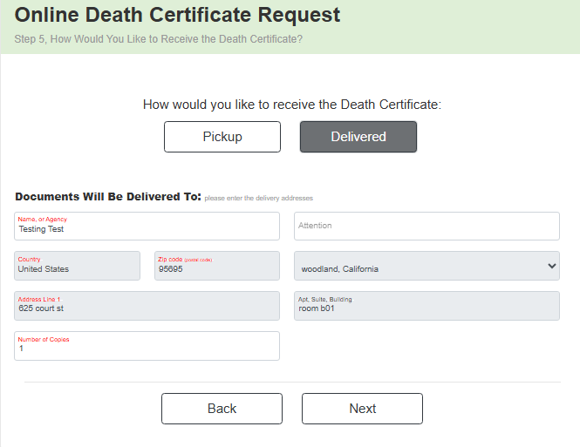
Standard Shipping does not come with tracking number.
Add the Requestor’s Initials to proceed to checkout.
Add the number of copies you want to request

Slide 35
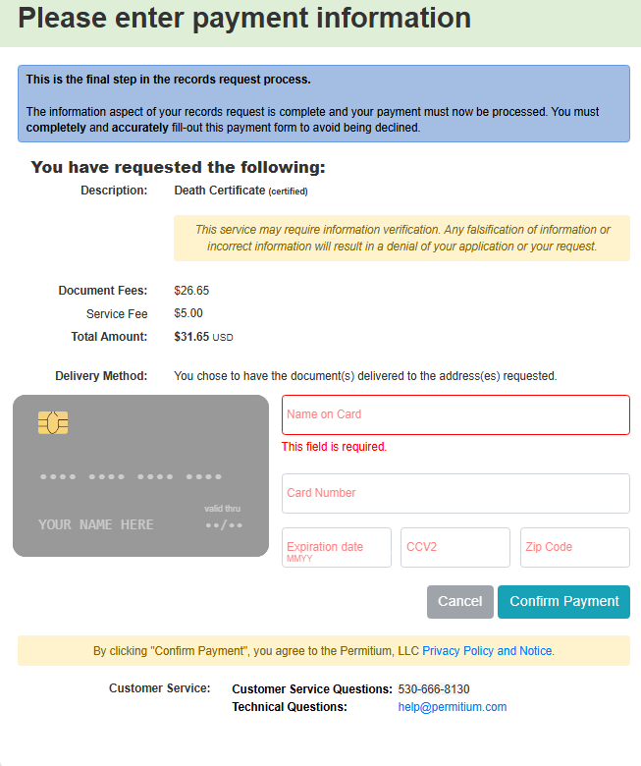
Payment Method must be US based, as well as address.
The CCV number are the 3 numbers in the back of the card.

Slide 36

Track the progress of your order

Slide 37
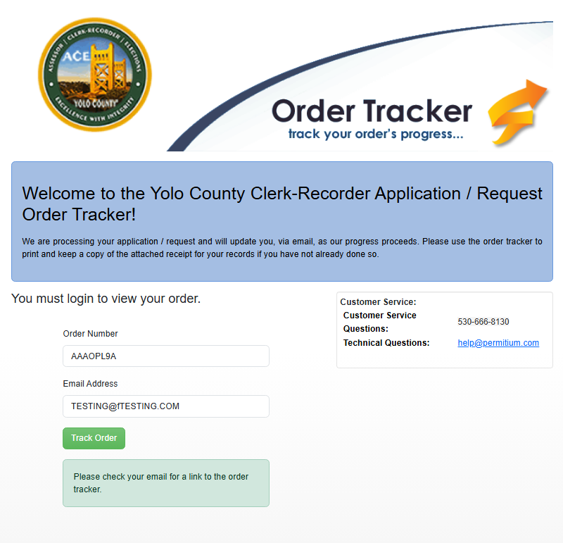
LINK:
https://yolovitals.permitium.com/order_tracker
Add the order number and email you provided.

